Slide 1


Consolidated Hazard Area and Compatible Land Use Zoning Regulations
2021 AMENDMENT

Slide 2
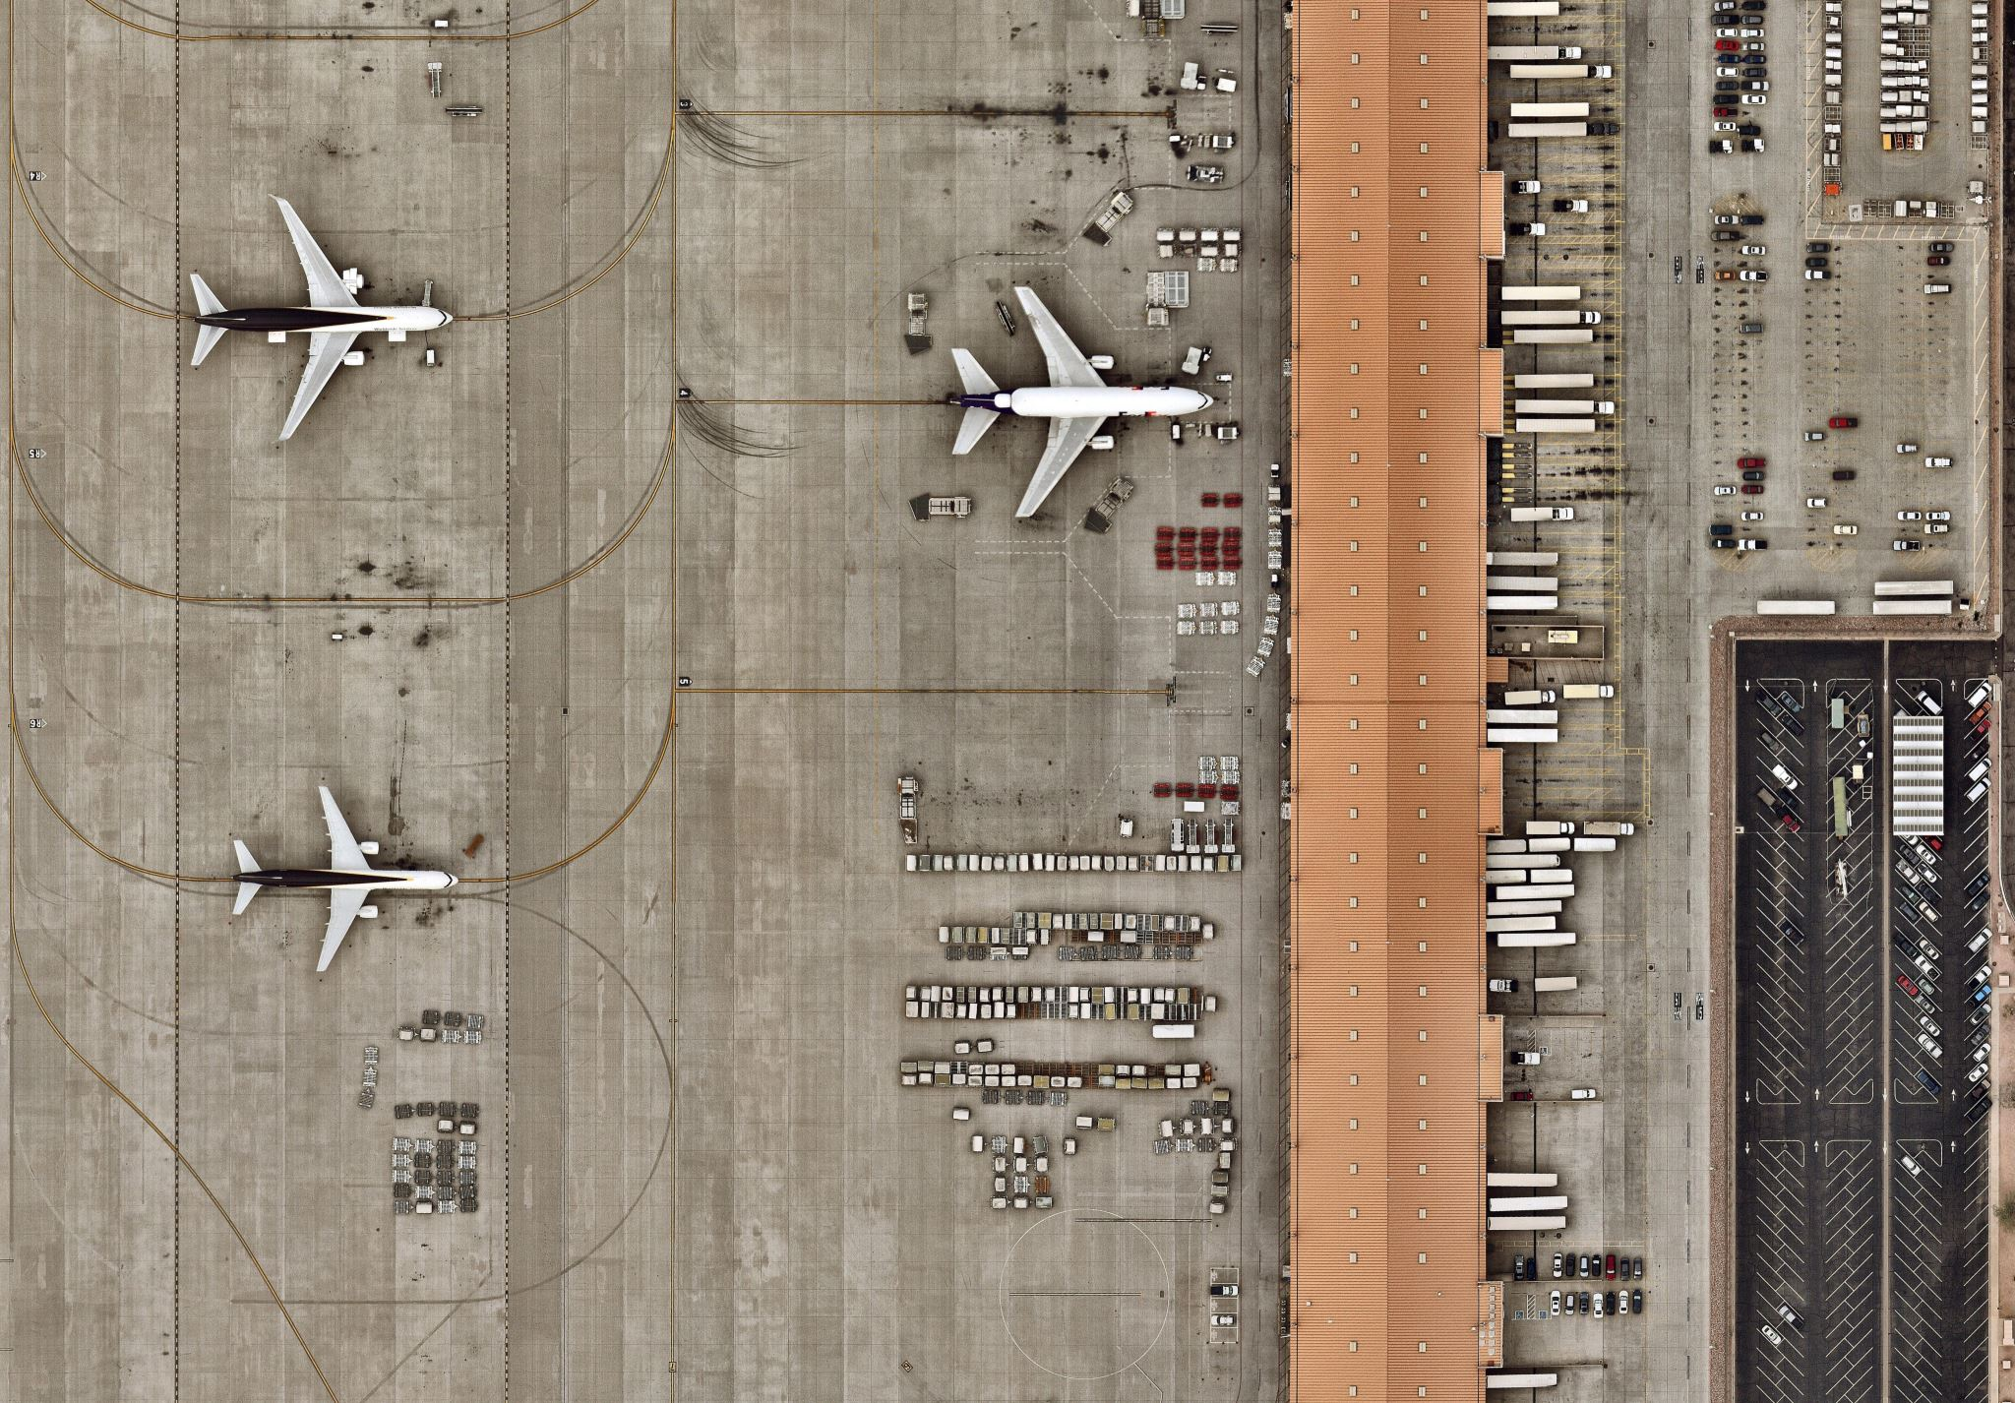
Consolidated Hazard Area and Compatible Land Use Zoning Regulations, explained
This is not a new ordinance - original ordinance adopted in 1966 by the Bay City-Matagorda County Joint Airport Zoning Board
Amendments to the current ordinance were adopted in 2000 – over 20+ years ago
Original short title was “Bay City Airport Zoning Ordinance”
Changed to “Consolidated Hazard Area and Compatible Land Use Zoning Regulations” to reflect the inclusion of hazard areas adjacent to the Airport property
Hereafter, for purposes of this presentation, referred to as “Airport Zoning Ordinance”

Slide 3

Airport Zoning Ordinance Amendment explained
Why does the Airport need a zoning ordinance?
Hazards and obstructions have the potential for endangering the lives and property of users of the Airport as well as property or occupants of land in vicinity of the Airport
Obstructions may affect existing and future instrument approach minimums
Obstructions may reduce the size of areas available for the landing, taking off and maneuvering of aircraft
Encroachment of noise-sensitive or other incompatible land uses adjacent to the Airport may endanger the health, safety and welfare of the owners, occupants or users of the land
Prevention of incompatible land uses and hazards to air navigation is in the best interest of the public health, safety and general welfare of airport users and adjacent property owners
Also, it is an FAA requirement for grant assurance

Slide 4

Airport Zoning Ordinance Amendment
What is new in the 2021 Amendment?
Reflect changes made by the FAA that affect the current ordinance
Updates are designed to implement FAA advisory instructions
Includes FAA guidance
Conforms to Texas Local Government Code Chapter 241
Most importantly, all changes aim to protect landowners and airport users!

Slide 5

Airport Zoning Ordinance Amendment Highlights
Definitions – added 16 new definitions for clarity
Permits – provides information about processing of permits
Maps – 4 maps added to show the footprint of required zones
Horizontal and Conical Surfaces
Approach and Transitional Surfaces
Airport Compatible Use Tiers
Wildlife Protection Control Zone
Form 7460-1, for reference

Slide 6
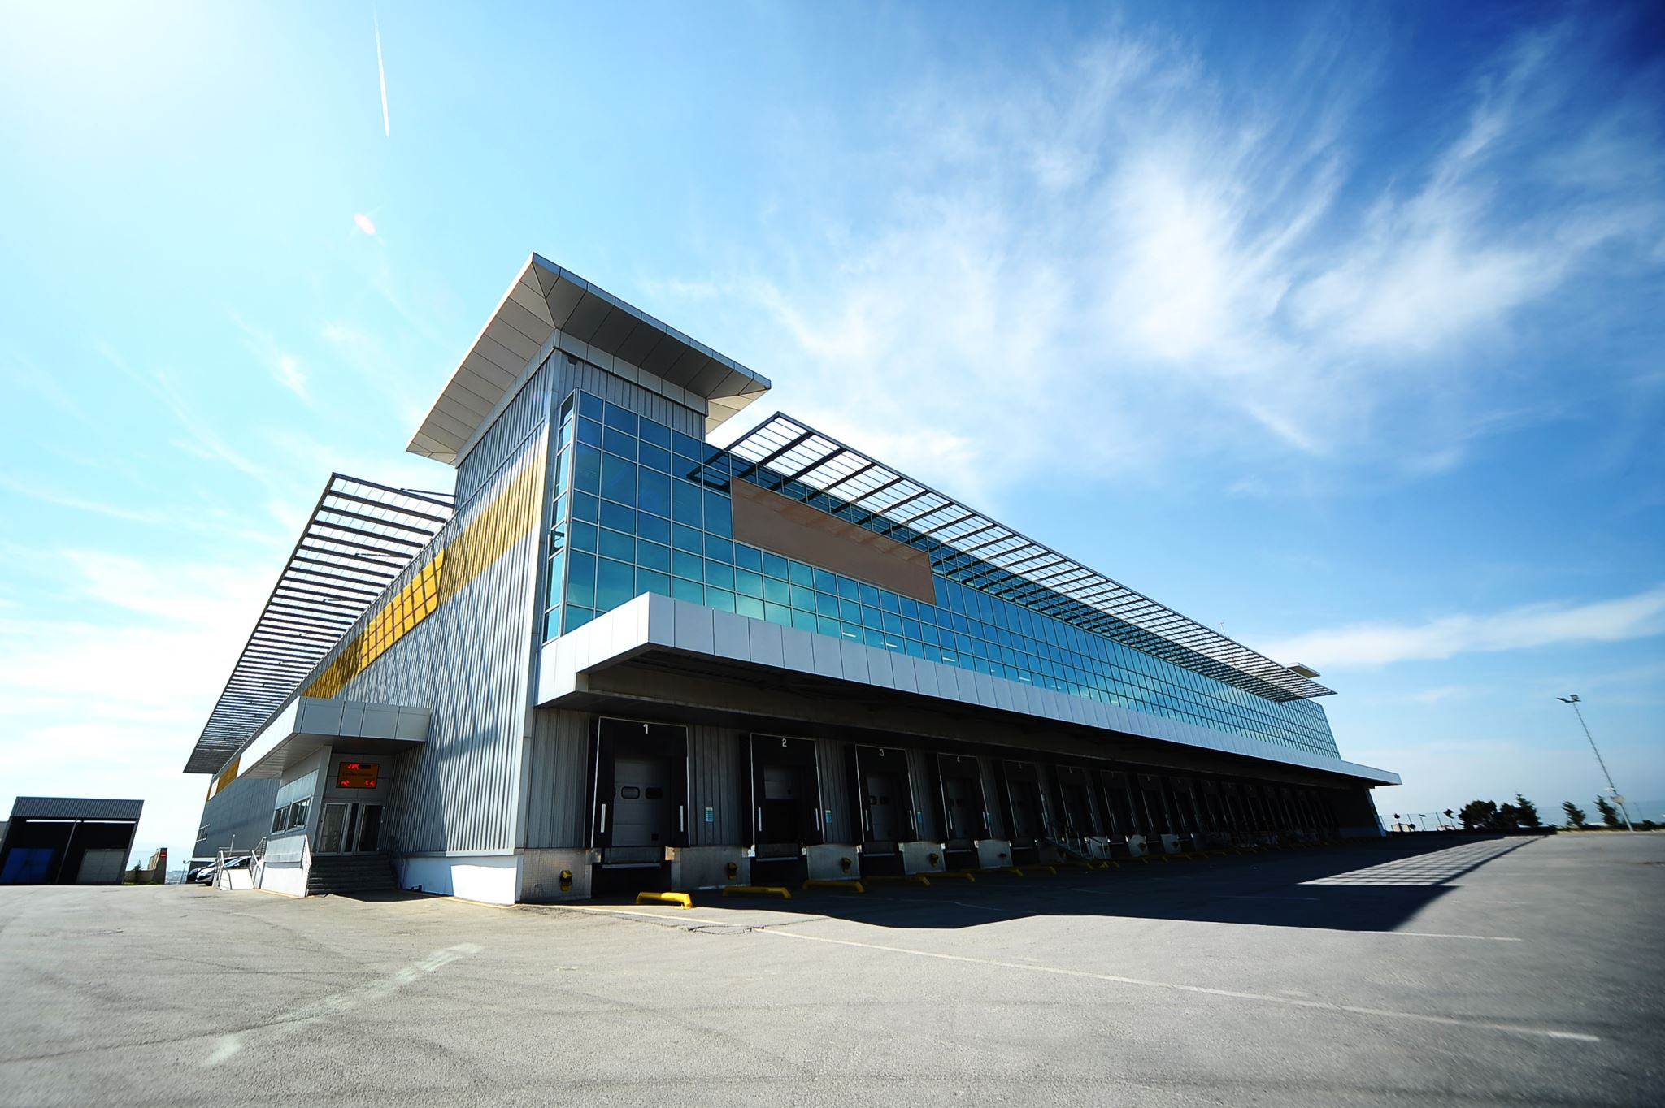
Airport Zoning Ordinance Amendment Highlights
Noise – notify landowners of potential noise hazard; requires the notice to be attached to property records when the property is sold or transferred
Structures and Uses – details height restrictions and uses that fall within certain areas (maps help determine land affected)
Zones – add more clarity to various zones and uses (maps define zones on the ground)
Amendments are not retroactive – explicitly states current uses and structures in place continue – no change required

Slide 7

Airport Zoning Ordinance Amendment Highlights
Height Limitations – expands discussion and adds map references to help determine where the rule applies
Wildlife Protection – zone added per FAA advisory instructions, and a map for clarity
Compatible Land Use – provides greater detail of rules and adds a map to help determine where the rule applies

Slide 8
Airport Zoning Ordinance Amendment Highlights
Variance process – provides greater detail about variance procedures
Variance request – explains that the FAA must render a determination about the variance request before it can be considered by the Board of Adjustment (submit Form 7460-1)
Lighting and Markings – if required by FAA on new construction, the property owner must comply, or permit will not be issued; if required by FAA on existing structures the City must install and maintain at City’s expense

Slide 9

Consolidated Hazard Area and Compatible Land Use Zoning Regulations
QUESTIONS?
James Mason, C.M., A.C.E.
Airport Manager
3598 FM 2540 North
Bay City, TX 77414
(979) 244-5037 office
(979) 429-0890 cell
www.FlyBayCity.com

